Slide 1

AI training group
Weekly Report
Nguyen khai phu – JUL 28 2023

Slide 2
PyTorch

Slide 3
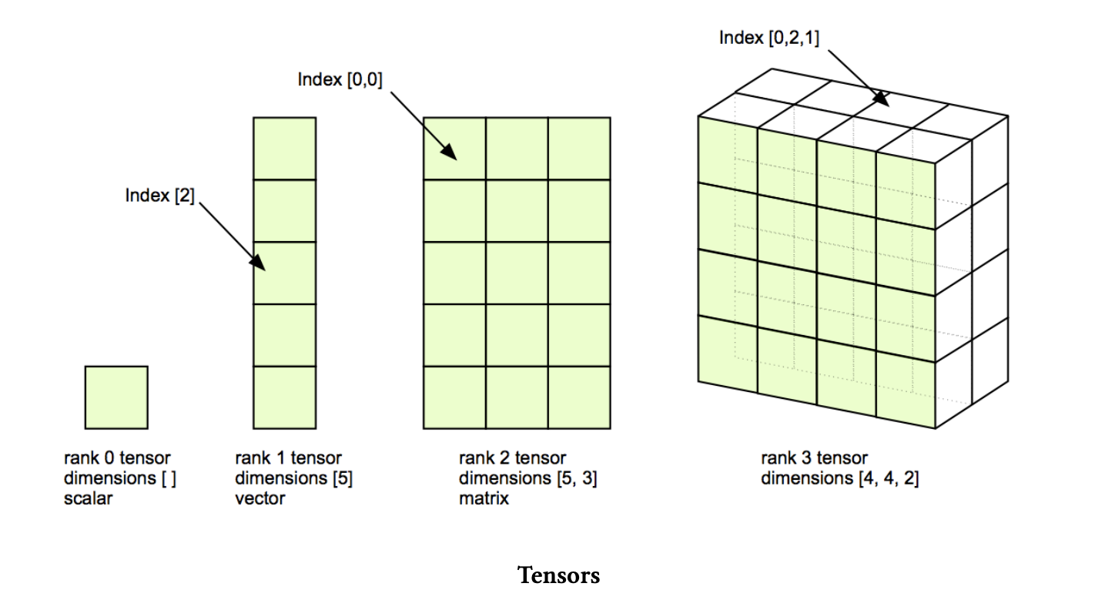
PyTorch
ISP008 foundation
Tensor is a generalized matrix of N dimensions
2
Internal | C/ISP Krautschneider | 07.12.2017 V1.0
CISP-1352-A21 - ISP-DOC-STYLETYPE-Templates © Robert Bosch GmbH 2016. All rights reserved, also regarding any disposal, exploitation, reproduction, editing, distribution, as well as in the event of applications for industrial property rights.

Slide 4
PyTorch – Useful modules
ISP008 foundation
Autograd
nn
nn.function
optim
torchvision: datasets, DataLoader
2
Internal | C/ISP Krautschneider | 07.12.2017 V1.0
CISP-1352-A21 - ISP-DOC-STYLETYPE-Templates © Robert Bosch GmbH 2016. All rights reserved, also regarding any disposal, exploitation, reproduction, editing, distribution, as well as in the event of applications for industrial property rights.

Slide 5
PyTorch – Training loop
ISP008 foundation
criterion = nn.MSELoss()
optimizer = torch.optim.Adam(model.parameters(),lr=0.001)
epochs = 50
losses = []
for i in range(epochs):
i += 1
pred = model.forward(x) //forward pass
loss = criterion(pred,y) //calculate loss
losses.append(loss) //record error
optimizer.zero_grad()
loss.backward() //backprop
optimizer.step() //updating params
2
Internal | C/ISP Krautschneider | 07.12.2017 V1.0
CISP-1352-A21 - ISP-DOC-STYLETYPE-Templates © Robert Bosch GmbH 2016. All rights reserved, also regarding any disposal, exploitation, reproduction, editing, distribution, as well as in the event of applications for industrial property rights.

Slide 6
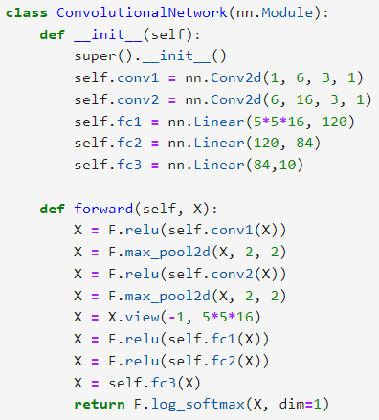
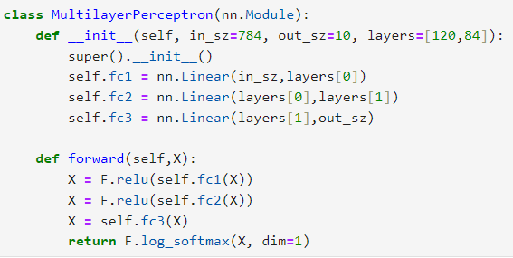
PyTorch – ANN & CNN
ISP008 foundation
2
Internal | C/ISP Krautschneider | 07.12.2017 V1.0
CISP-1352-A21 - ISP-DOC-STYLETYPE-Templates © Robert Bosch GmbH 2016. All rights reserved, also regarding any disposal, exploitation, reproduction, editing, distribution, as well as in the event of applications for industrial property rights.

Slide 7
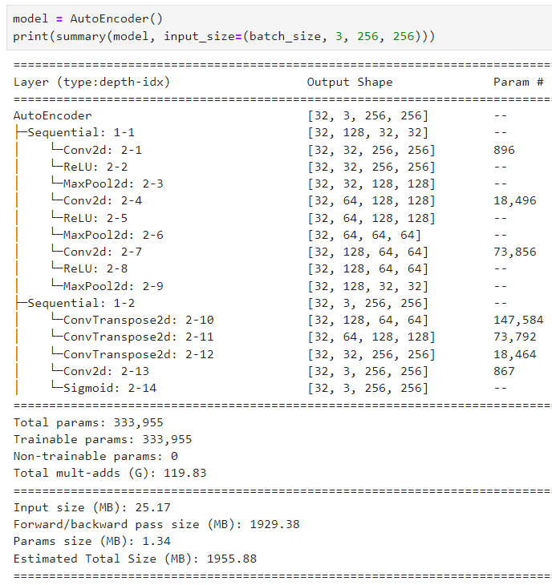
PyTorch – ANN & CNN
ISP008 foundation
torchinfo
2
Internal | C/ISP Krautschneider | 07.12.2017 V1.0
CISP-1352-A21 - ISP-DOC-STYLETYPE-Templates © Robert Bosch GmbH 2016. All rights reserved, also regarding any disposal, exploitation, reproduction, editing, distribution, as well as in the event of applications for industrial property rights.

Slide 8
Video defect detection using Deep Learning Techniques

Slide 9
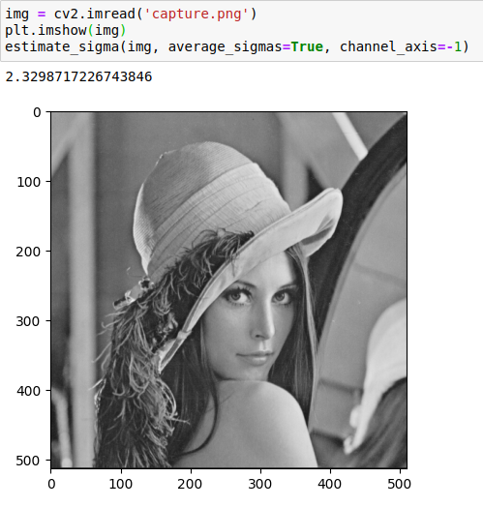
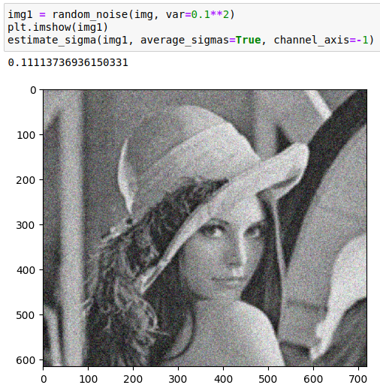
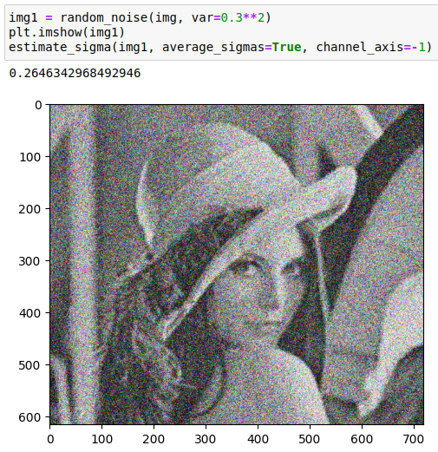
Impulse noise
ISP008 foundation
An objective evaluation method should includes:
A metric to measure “noise level”
Threshold to determine noisy images
2
Internal | C/ISP Krautschneider | 07.12.2017 V1.0
CISP-1352-A21 - ISP-DOC-STYLETYPE-Templates © Robert Bosch GmbH 2016. All rights reserved, also regarding any disposal, exploitation, reproduction, editing, distribution, as well as in the event of applications for industrial property rights.

Slide 10
Impulse noise
ISP008 foundation
skimage, opencv,… -> too inconsistent
Convolutional Neural Networks
2 approaches:
Denoise with CNN -> calculate dissimilarity -> threshold
Binary classification: normal/noisy
2
Internal | C/ISP Krautschneider | 07.12.2017 V1.0
CISP-1352-A21 - ISP-DOC-STYLETYPE-Templates © Robert Bosch GmbH 2016. All rights reserved, also regarding any disposal, exploitation, reproduction, editing, distribution, as well as in the event of applications for industrial property rights.

Slide 11
Impulse noise
ISP008 foundation
Smartphone Image Denoising Dataset (SIDD)
Captured by smartphones under different lighting conditions, different scenes, different camera configurations
3 sizes:
Small size: 6GB, 160 pairs of noisy/ground truth images
Medium size: 12GB, 320 pairs of noisy/ground truth images
Full size: 24000 pairs of noisy/ground truth images
2
Internal | C/ISP Krautschneider | 07.12.2017 V1.0
CISP-1352-A21 - ISP-DOC-STYLETYPE-Templates © Robert Bosch GmbH 2016. All rights reserved, also regarding any disposal, exploitation, reproduction, editing, distribution, as well as in the event of applications for industrial property rights.

Slide 12
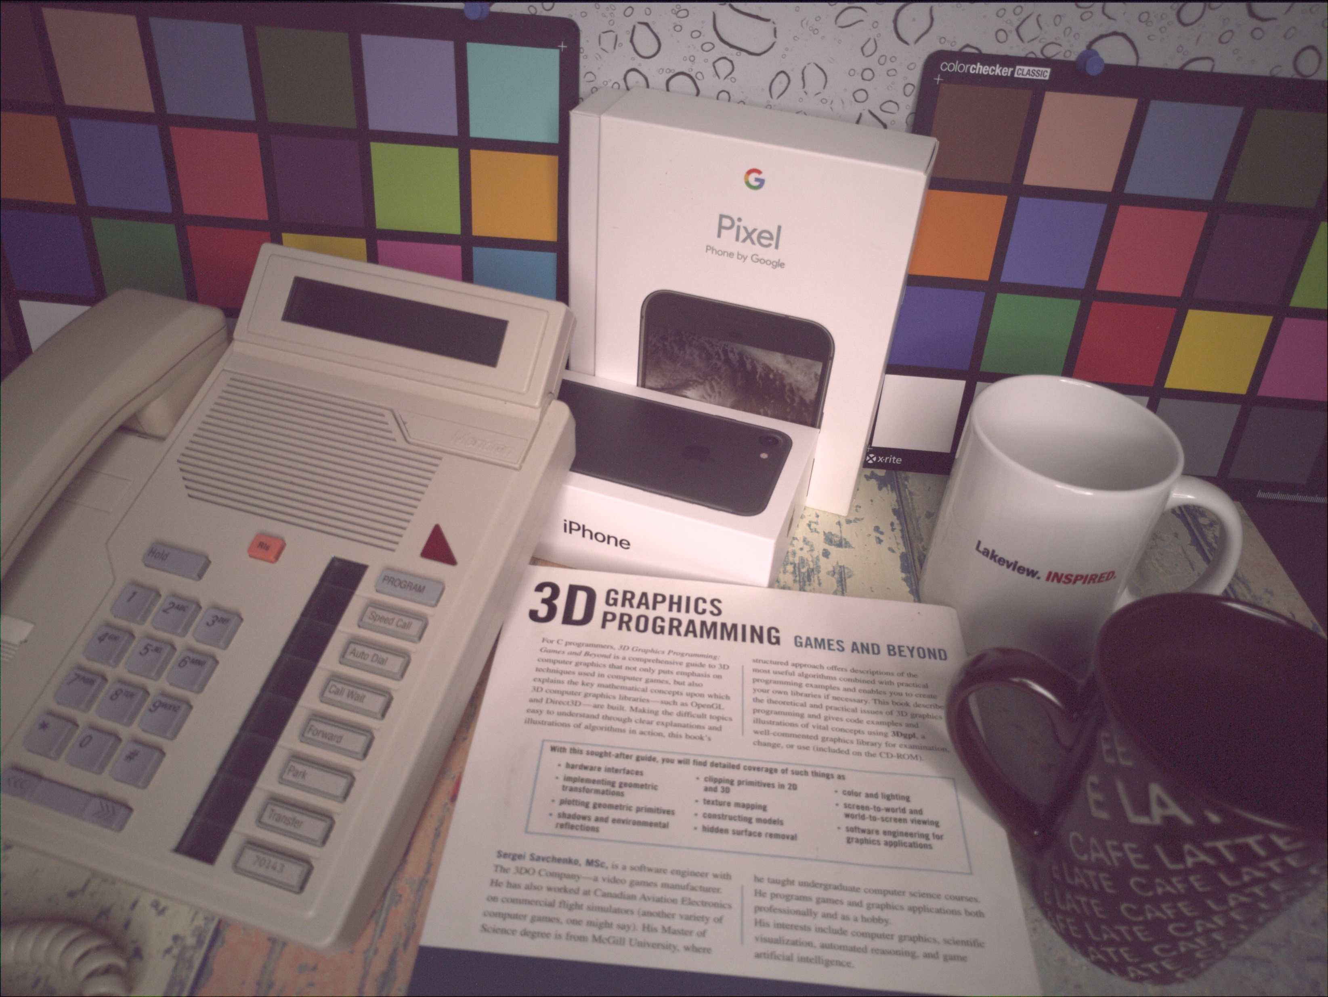
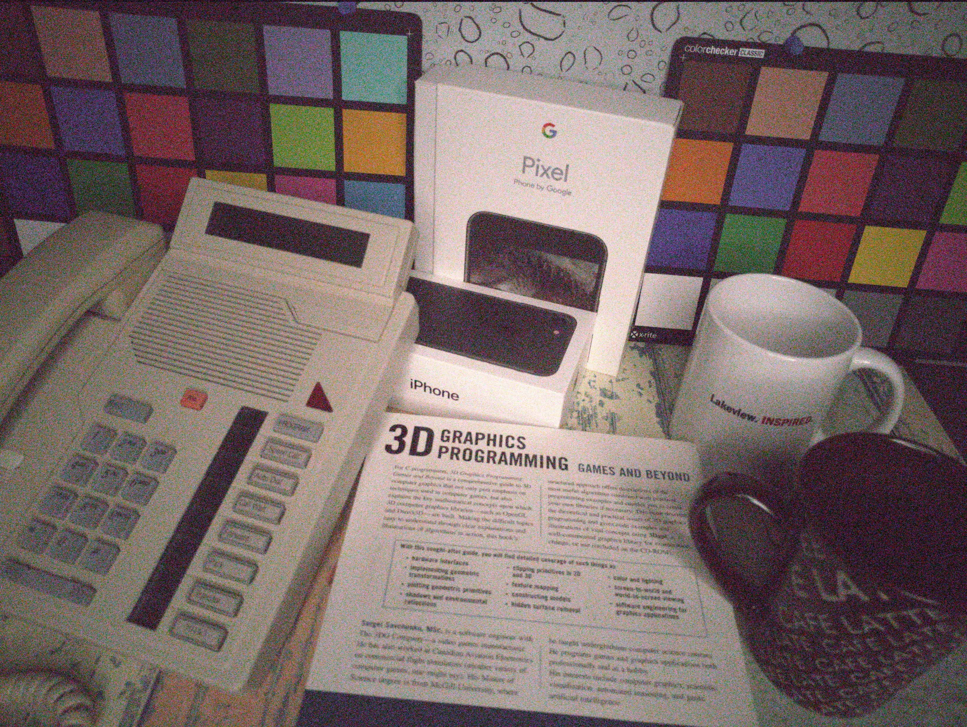
Impulse noise
ISP008 foundation
2
Internal | C/ISP Krautschneider | 07.12.2017 V1.0
CISP-1352-A21 - ISP-DOC-STYLETYPE-Templates © Robert Bosch GmbH 2016. All rights reserved, also regarding any disposal, exploitation, reproduction, editing, distribution, as well as in the event of applications for industrial property rights.

Slide 13
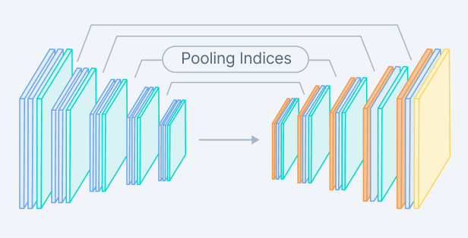
Impulse noise
ISP008 foundation
Convolutional Autoencoders
2
Internal | C/ISP Krautschneider | 07.12.2017 V1.0
CISP-1352-A21 - ISP-DOC-STYLETYPE-Templates © Robert Bosch GmbH 2016. All rights reserved, also regarding any disposal, exploitation, reproduction, editing, distribution, as well as in the event of applications for industrial property rights.

Slide 14
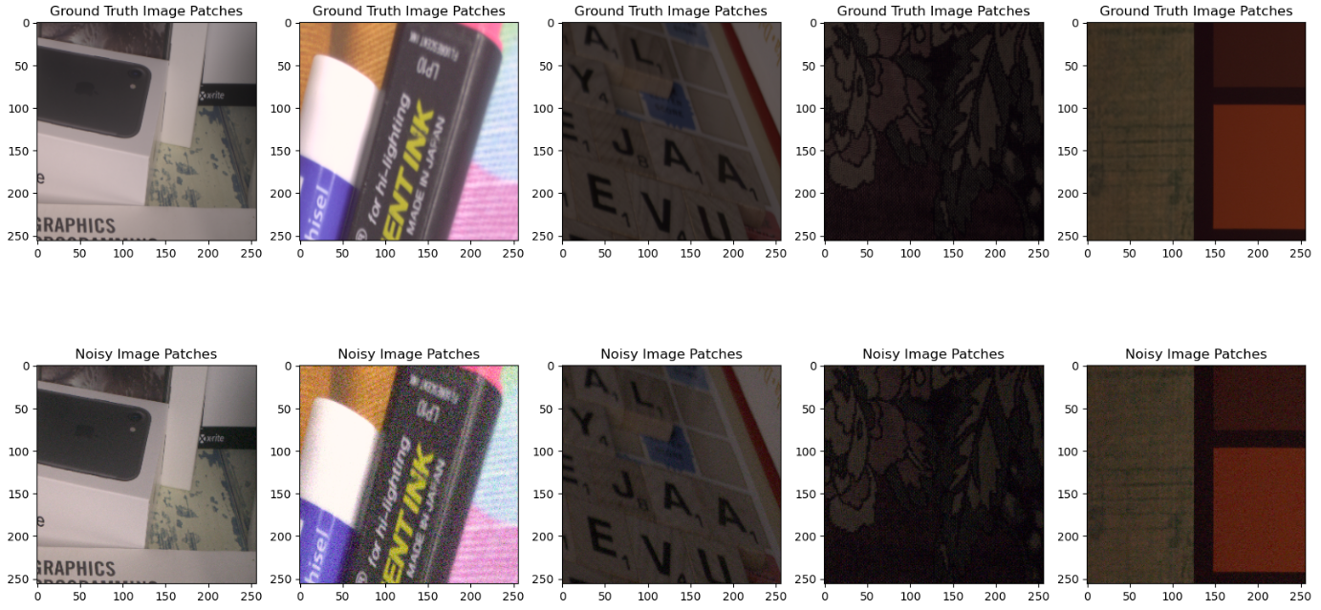
Impulse noise
ISP008 foundation
Convolutional Autoencoders
Patchify
2
Internal | C/ISP Krautschneider | 07.12.2017 V1.0
CISP-1352-A21 - ISP-DOC-STYLETYPE-Templates © Robert Bosch GmbH 2016. All rights reserved, also regarding any disposal, exploitation, reproduction, editing, distribution, as well as in the event of applications for industrial property rights.

Slide 15
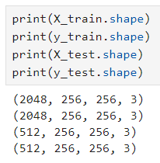
Impulse noise
ISP008 foundation
Convolutional Autoencoders
Patchify
train_test_split
2
Internal | C/ISP Krautschneider | 07.12.2017 V1.0
CISP-1352-A21 - ISP-DOC-STYLETYPE-Templates © Robert Bosch GmbH 2016. All rights reserved, also regarding any disposal, exploitation, reproduction, editing, distribution, as well as in the event of applications for industrial property rights.

Slide 16
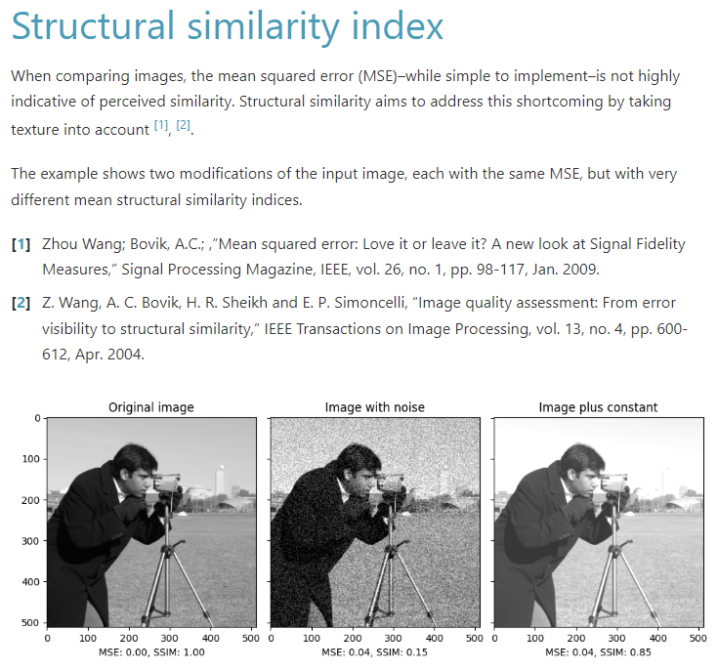
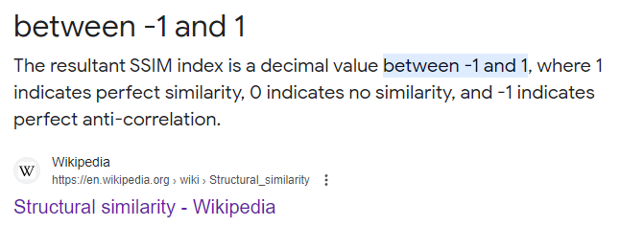
Impulse noise
ISP008 foundation
Convolutional Autoencoders
Patchify
train_test_split
Image similarity: SSIM
2
Internal | C/ISP Krautschneider | 07.12.2017 V1.0
CISP-1352-A21 - ISP-DOC-STYLETYPE-Templates © Robert Bosch GmbH 2016. All rights reserved, also regarding any disposal, exploitation, reproduction, editing, distribution, as well as in the event of applications for industrial property rights.

Slide 17
Impulse noise
ISP008 foundation
Apply SSIM for 512 ground truth patches and 512 noisy patches, using the denoised patches produced by the Autoencoder
2
Internal | C/ISP Krautschneider | 07.12.2017 V1.0
CISP-1352-A21 - ISP-DOC-STYLETYPE-Templates © Robert Bosch GmbH 2016. All rights reserved, also regarding any disposal, exploitation, reproduction, editing, distribution, as well as in the event of applications for industrial property rights.

Slide 18
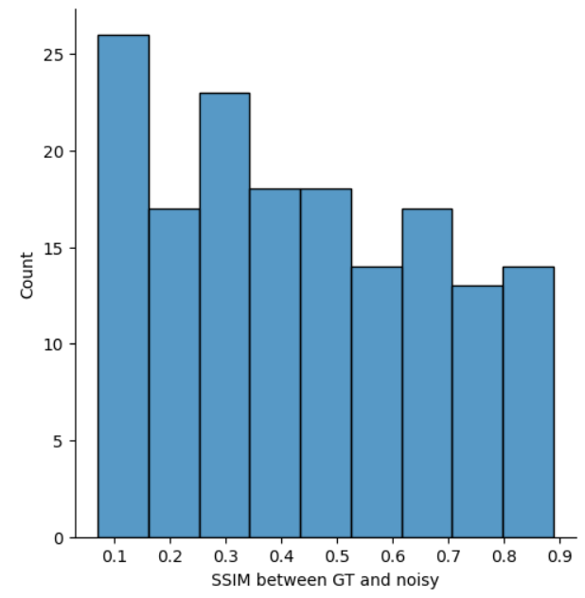
Impulse noise
ISP008 foundation
Apply SSIM for 512 ground truth patches and 512 noisy patches, using the denoised patches produced by the Autoencoder
Select SSIM value: 0.56 (only ~25% of dataset > 0.56)
2
Internal | C/ISP Krautschneider | 07.12.2017 V1.0
CISP-1352-A21 - ISP-DOC-STYLETYPE-Templates © Robert Bosch GmbH 2016. All rights reserved, also regarding any disposal, exploitation, reproduction, editing, distribution, as well as in the event of applications for industrial property rights.

Slide 19
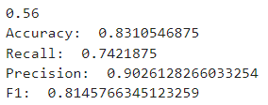
Impulse noise
ISP008 foundation
Apply SSIM for 512 ground truth patches and 512 noisy patches, using the denoised patches produced by the Autoencoder
At SSIM = 0.56
2
Internal | C/ISP Krautschneider | 07.12.2017 V1.0
CISP-1352-A21 - ISP-DOC-STYLETYPE-Templates © Robert Bosch GmbH 2016. All rights reserved, also regarding any disposal, exploitation, reproduction, editing, distribution, as well as in the event of applications for industrial property rights.

Slide 20
Reference
ISP008 foundation
What is Tensor? - ILTER (hkilter.com)
SIDD_CVPR_2018.pdf (yorku.ca)
Autoencoders in Deep Learning: Tutorial & Use Cases [2023] (v7labs.com)
Image Denoising using Deep Learning | by Sharath Solomon | Analytics Vidhya | Medium
2
Internal | C/ISP Krautschneider | 07.12.2017 V1.0
CISP-1352-A21 - ISP-DOC-STYLETYPE-Templates © Robert Bosch GmbH 2016. All rights reserved, also regarding any disposal, exploitation, reproduction, editing, distribution, as well as in the event of applications for industrial property rights.

